Slide 1

SQL MINI PROJECT
We have data from the car sales company, named “cars24”.
There are Information of fuel type, name of cars, model of year Etc.
we want to need useful insights that help the business to grow

Slide 2
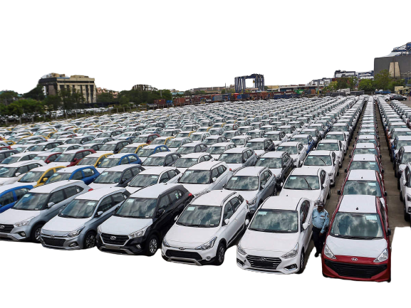

About Cars24
CARS24 is a leading AutoTech company streamlining and revolutionizing the sale, purchase, and financing of pre-owned cars in India. It Purchases and sells used cars. It is a service based company but in some regions it does operations as well.

Slide 3

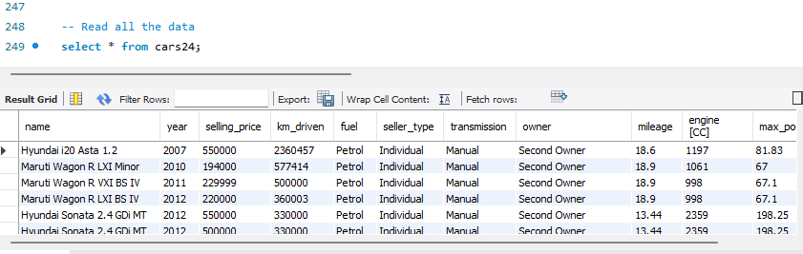
Read All The Data
Querry : select * from cars24;
Output

Slide 4

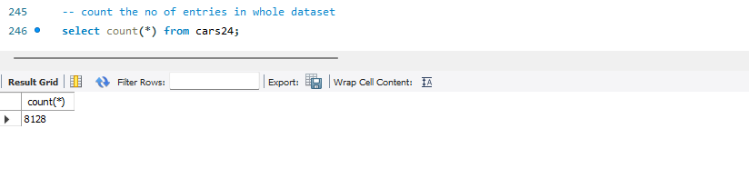
Count The Numbers of Entries
Querry : select count(*) from cars24;
Comments : In the dataset we have 8128 entries. So we can say that we have 8128 units of cars in the given dataset.
Output

Slide 5
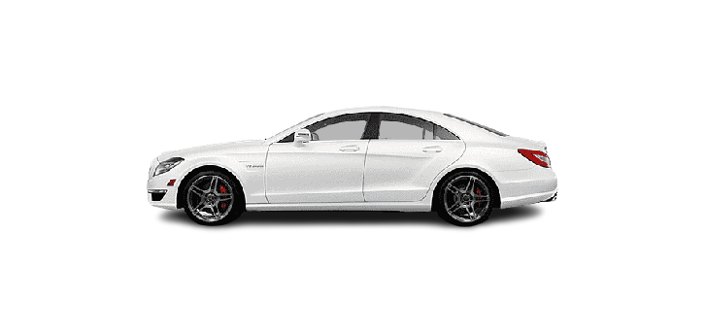
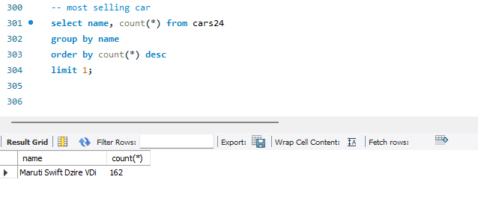
Most Selling Car
Querry : select name, count(*) as total from cars24
group by name
order by total desc
Limit 1;
Comment : Throughout The Years, The Most Selling Car is “Maruti Swift Dzire VDi” and 162 units sold of this Car. But That Model of Car Consider all Fuel Types like Petrol, Diesels & CNG. But We also want to know that which Car is Most sold by Fuel Type
Output

Slide 6
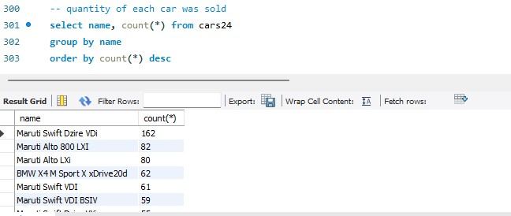
Analyse What Units of Each Car was Sold
Querry : select name, count(*) as Count from cars24
group by name
order by Count desc
Comment : here we can see How Many Cars were Sold in each Model.
Output

Slide 7

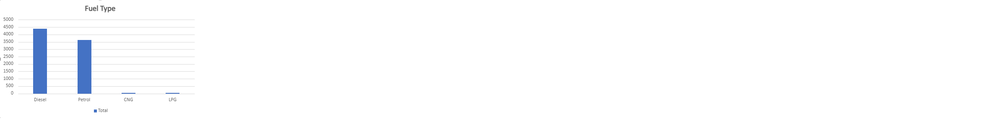
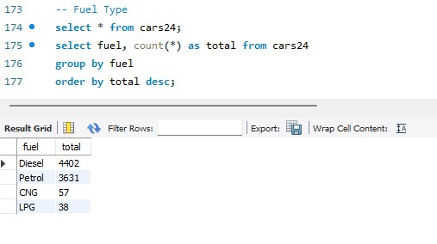
Analyse Count of Fuel Type
Query : select fuel, count(*) as total from cars24
group by fuel
order by total desc;
Comment : We Analyse that the most Selling car in Fuel type is “Diesel”. So in future We Could More Concentrated in Diesel Cars and less Concentrated in LPG Cars
Output

Slide 8

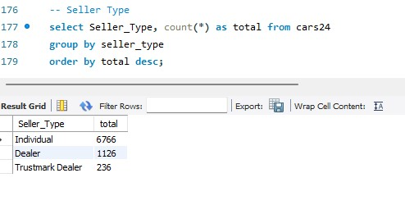
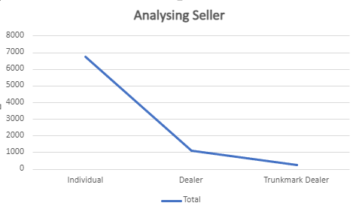
Analyse Seller
Query : select Seller_Type, count(*) as total from cars24
group by seller_type
order by total desc;
Comment : The Most Selling Car Belongs to Individuals. In 2nd Place, Dealers Sell the Most Cars. But there is Huge Gap in Between. We Analyze that individual Sales around 6500 cars and dealers sell around 1100. Individuals are an Expensive process for our company so we should concentrate more on Dealers and trustmark dealers. If it is not, so we are good in seller_type
Output

Slide 9

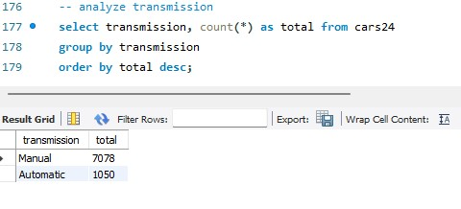
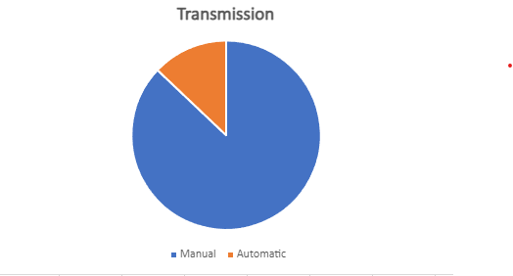
Analyse Transmission
Query : select transmission, count(*) as total from cars24
group by transmission
order by total desc;
Comments : We analyse that the manual transmission’s cars are more in demand. There is about 7X more demand for manuals compared with Automatic. People are more interested in Manuals
Output

Slide 10

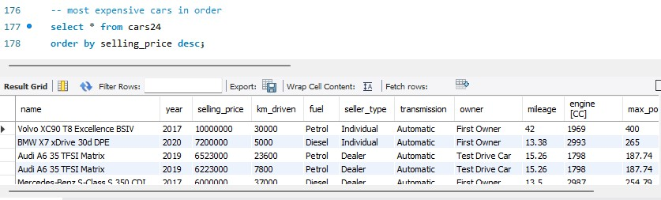
Most Expensive Cars
Query : select * from cars24
order by selling_price desc;
Comments : The Most Expensive car in our data is “Volvo XC90 T8 Excellence BSIV”.
Note : We can also Find the Cheapest Car. For order of Cheapest cars we Replace desc to asc at last. Then We get the cheapest cars in order
Output

Slide 11

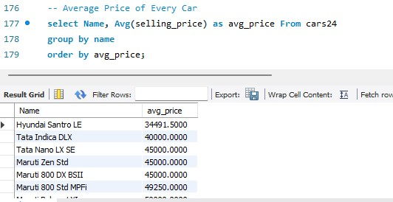
Average Price of Every Car
Query : select Name, Avg(selling_price) as avg_price From cars24
group by name
order by avg_price;
Comment : Note that the Price of every car is decided by various factors like km Driven, model of car, condition of car and the mentality of the seller. But by the Average Price of car, We Decide the average value of every car
Output

Slide 12

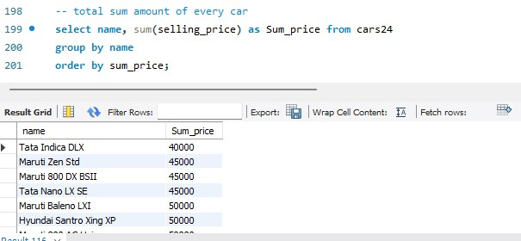
Total Sum Amount of Every Car
Query : select name, sum(selling_price) as Sum_price from cars24
group by name
order by sum_price;
Comment : We can See tha “Tata Indica DLX” Generates less amount of Money. But Note That, it also depends on unit sales. If More units car are sold then the sum amount will also be more
Output

Slide 13

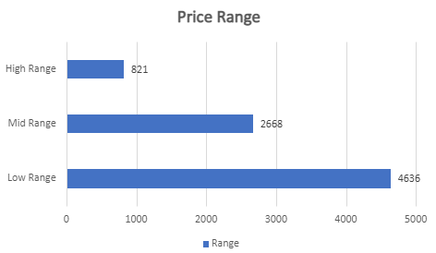
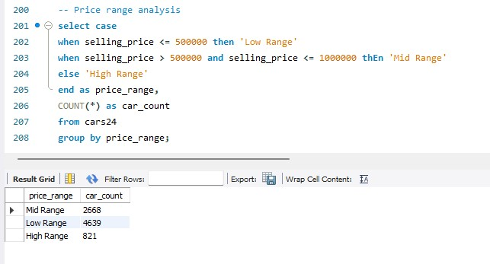
Price Range Analysis
Query : select case
when selling_price <= 500000 then 'Low Range' when selling_price > 500000 and selling_price <= 1000000 then 'Mid Range' else 'High Range'
end as price_range, COUNT(*) as car_count from cars24
group by price_range;
Comment : We Divide the Price range into three parts - Low Range, Mid Range and High Range. Now we can easily decide in which range the most cars were sold. We clearly see that low price range cars are sold more in quantity. People use to buy the cars which price is less than 5 Lakhs
Output

Slide 14

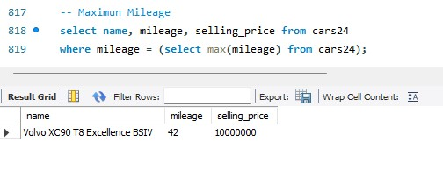
Maximum Mileage
Query : select name, mileage, Selling_price from cars24
where mileage = (select max(mileage) from cars24);
Comment : So, “Volvo XC90 T8 Excellence BSIV” Gives Best Mileage. But for Indian People price is most Crucial Point and this car is Sell at 1 Cr. But anyhow it gives Best Mileage
Output

Slide 15

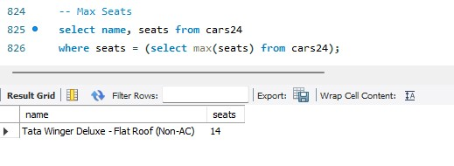
Max Seats
Query : select name, seats from cars24
where seats = (select max(seats) from cars24);
Comment : Some People Prefer a Type of Car which Has Most Number of Seats. We can say it is a Family Car. So by this stat we tell them a car which has 14 seats
Output

Slide 16
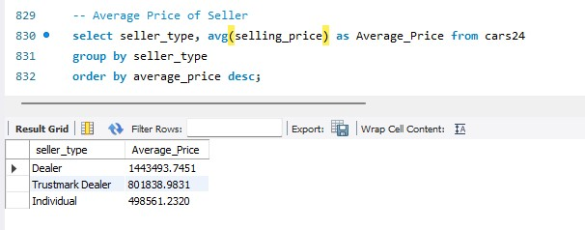
Average Price of Seller
Query : select seller_type, avg(selling_price) as Average_Price from cars24
group by seller_type
order by average_price desc;
Comment : It is also Important Which Seller is Most Relevant and Useful for us. For Business, It is Important that What Quantity was Sold By Which Seller but it is also important that which Seller Generates Most of The Income.
Output

Slide 17

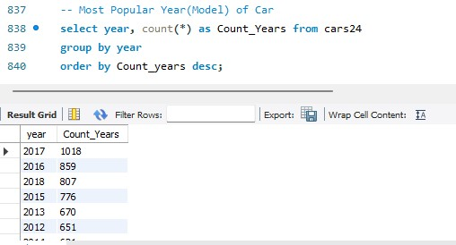
Most Popular Year (Model) of Car
Query : select year, count(*) as Count_Years from cars24
group by year
order by Count_years desc;
Comments : Customers Like to Buy 2017’s Model of Car and follow by 2016 & 2018. So Next Year use Concentrate on 2018’s Model of Car Following by 2017 & 2019.
Output

Slide 18

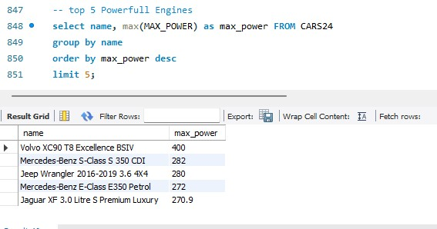
Top 5 Powerful Engines
Query : select name, max(MAX_POWER) as max_power FROM CARS24
group by name
order by max_power desc limit 5;
Comments : Some Customers Always want Powerful Engines, even in second hand cars. So this stats is matter for us because if somebody wants a cars which have max power, so by this stats we tell them them some of cars.
Output

Slide 19

Summary
Get More Results
Future Projection
Improvement
Focus on Key Points

Slide 20
THANK YOU
Myself : Name : Kamal Kumar
Batch : Capds_053
Contact : 8725920612
Thank You : I am Deeply Grateful to You for Providing This Project, It Helps Me a lot to understand about the Business. It is Common that i Must have made mistakes in this Project. But I do My best and i will
Q&A : If You Have Any Questions, You Can Directly Contact me. My Contact Information is Write Above

